Slide 1
BigWallet
Catchy slogan

Slide 2
Elevator pitch

Slide 3
Concept
Description - A application that can help a user save money
Motivation for development? Trouble saving because you can't keep track of the money you save
User story
AS A user, I want to be able to save money
I WANT to be able to keep track of what I spend my money on
SO THAT I can organize my budgets more efficiently

Slide 4
Process
Technologies used
Breakdown of tasks and roles
Challenges
Successes

Slide 5
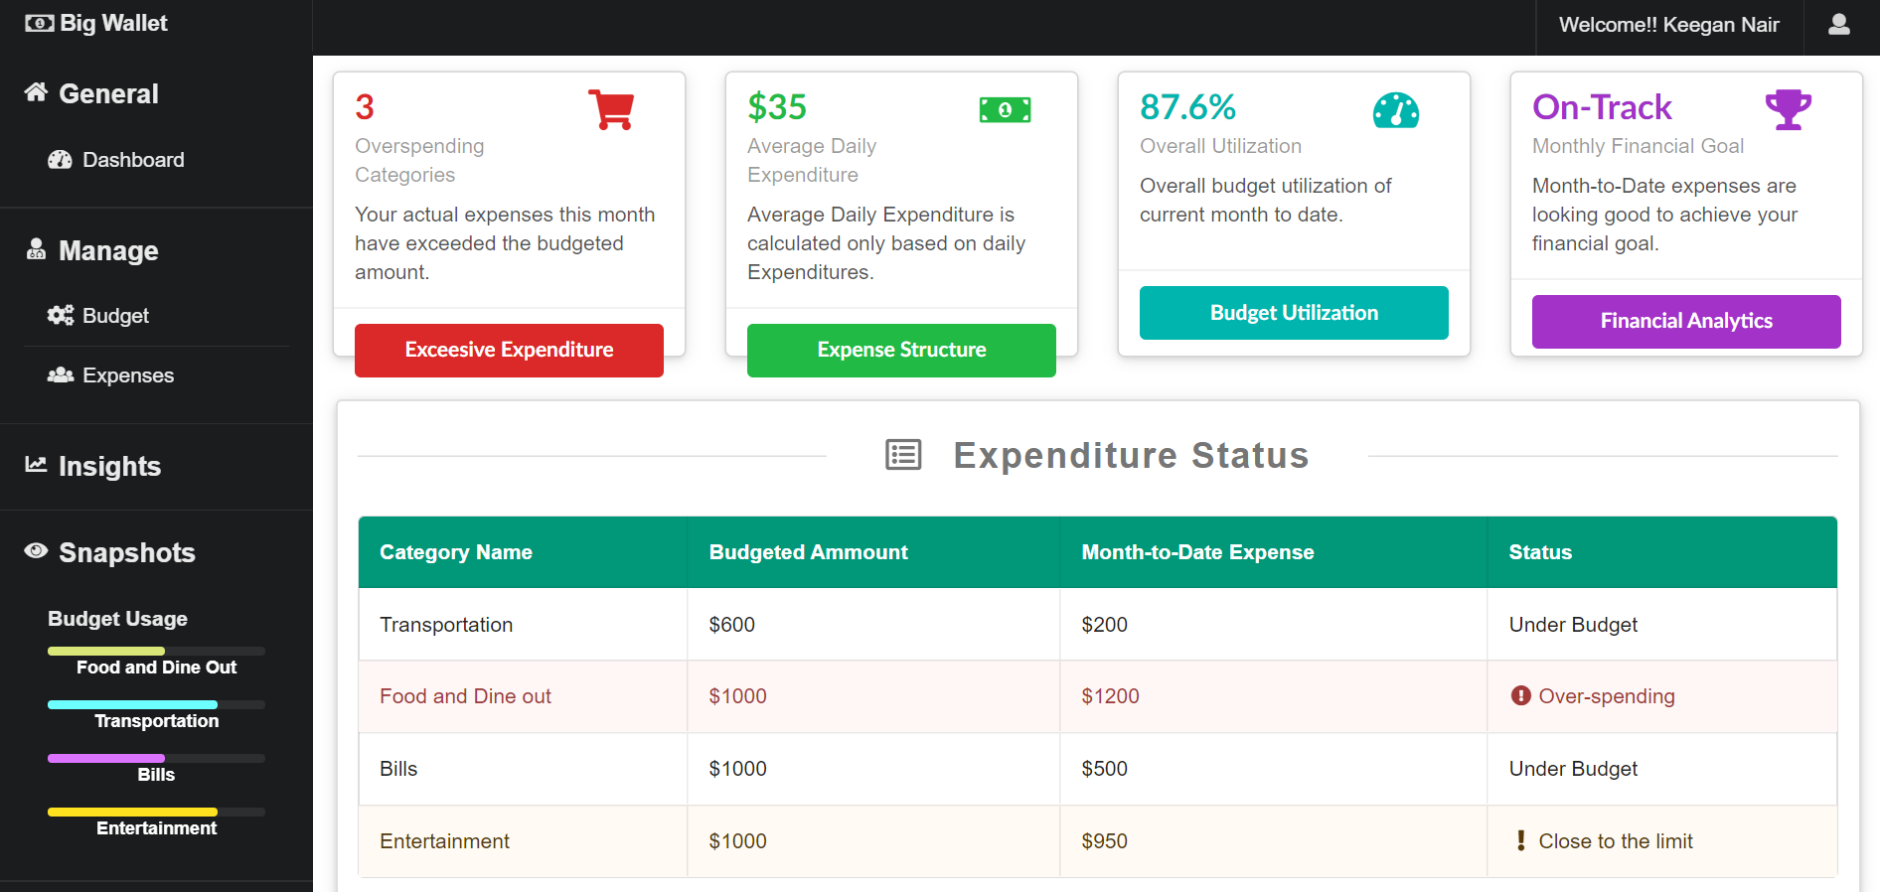
Demo

Slide 6
Directions for Future Development

Slide 7
Links
Deployed
GitHub repo

